Slide 1
PowerPoint Accessibility Guide
Designing a Web-based Training (WBT) for use in TrainTraq

Slide 2
Introduction
The following slides provide example slides and tips for enhancing the accessibility of a WBT designed for use in TrainTraq, the Texas A&M University System Learning Management System (LMS).
The tips provided can be used to edit this file for use, or to help you edit an existing PowerPoint you intend to publish for use in TrainTraq.
If using this PowerPoint file, once you are finished editing and have applied the tips mentioned, delete the instructional slides.
Tips mentioned are taken from PowerPoint Accessibility by WebAIM.org.

Slide 3
How to Use This Guide
Slide 4, “Example of a Course Title Slide” provides suggested information to provide users at the beginning of the course. Edit to meet your specific needs.
Slide 5, “Example of a Navigation Slide” provides the keyboard shortcuts that would be available if this course was published in Articulate Studio ’13 or Articulate Studio 360. Depending on what features you have in your course, not all will apply, so read carefully, and remove any that won’t be available. If publishing this course in a different eLearning authoring tool, verify what is available and update accordingly.
The remaining slides contain tips to make your PowerPoint more accessible. How accessible your WBT is depends on you, the developer.
If you prefer to view the remaining tips online, please review the following article, PowerPoint Accessibility by WebAIM.org.

Slide 4
Example of a Course Title Slide
Instructions: For people using screen readers, the course title text box will be the first object read. Instructions on how to navigate by screen reader has been added to the alt text. Edit the alt text to add the name of the course.
Select the course title text box.
Right-click and select, Format Shape.
Select the Size and Properties icon (third from left under Format Shape menu)
Scroll to bottom, and locate Alt Text.
Update the Description.
Delete this caption when done.
If you need this course in an alternative format, download the text version by clicking the Resources link, or contact the training department at abc@email.com.
Audio: Yes/No
Time: 20-30 minutes
Notes:
It’s recommended to provide the following information to users on the first slide: how to obtain an alternative version, if they should expect audio, and how much time is estimated to complete the course.

Slide 5
Example of Navigation Slide
If navigating with a keyboard, the following are the keyboard shortcuts. [Note to developer: delete the functions below you’re not providing. For example, if not including audio, delete “M” and “Mute/unmute”.]
Key | Function
Tab | Jump to objects on the slide and player
Arrow Left, Arrow Up, or Page Up | Jump to the previous slide
Arrow Right, Arrow Down, or Page Down | Jump to the next slide
Home | Jump to the first slide
End | Jump to the last slide
Spacebar | Play/pause or activate links or buttons
Enter | Activate links or buttons
M | Mute/unmute
N | Open the Notes tab
O | Open the Menu tab
R | Open the Resources tab

Slide 6
Alternative Version
Adhering to the following guidelines will enhance the accessibility of your WBT, however, it doesn’t guarantee it will be accessible for everyone.
With that in mind, it’s best practice to have an accessible text version available in the event you received a request for an accommodation.
There are a couple of ways to approach this:
Have an accessible PowerPoint available. Keep in mind that it may differ than the PowerPoint version you published as a WBT. For example, if your WBT had audio and animations, your text version would be a PowerPoint with no audio and the narration text added to the slides, and following the same tips outlined in this guide.
Create an accessible text version in Microsoft Word. To streamline development, it’s good practice to finalize content and create a text version in Word before developing your WBT version in PowerPoint. See the following article, Creating Accessible Documents.

Slide 7
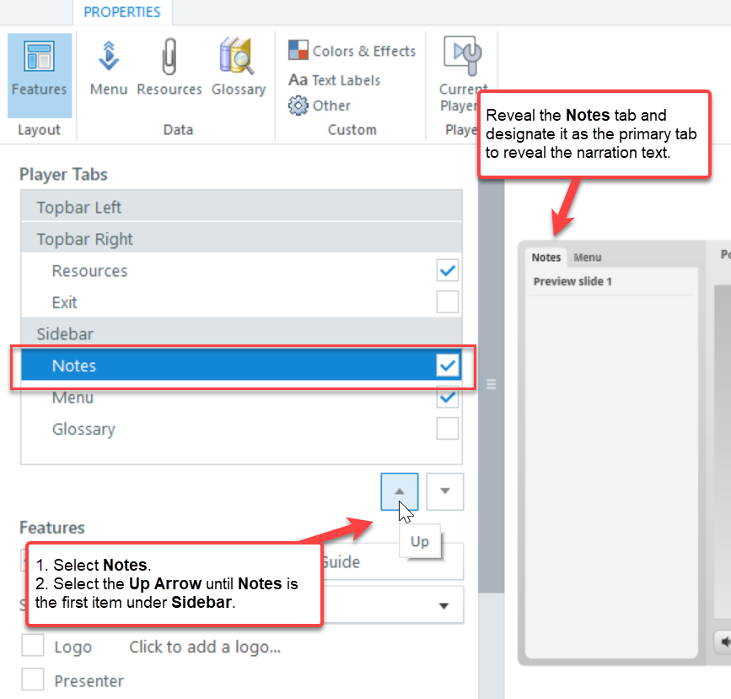
Adding Audio
If including audio in your WBT, include the narration text in the Notes pane below the slide.
If you are publishing the course, reveal the Notes panel in the Articulate course player:
Go to Articulate ribbon.
Select Player.
Under Sidebar, select Notes.
Select the Up Arrow until Notes is the first item under the Sidebar.
Notes:
This is where you would type the narration text. When you reveal the Notes tab in the Articulate course player, this is the text that will be revealed.

Slide 8
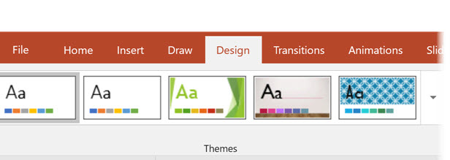
Templates and Themes
Choose a theme or template with good contrast and simple backgrounds to improve readability.
This guide provides sufficient contrast.

Slide 9
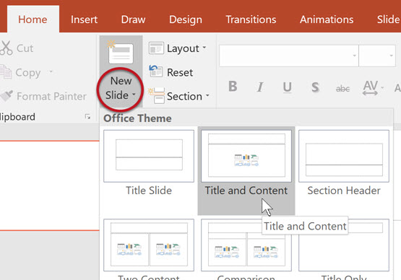
Slide Layouts
Make your PowerPoint easier to navigate for screen readers by using the layouts provided in PowerPoint.
Use slide layouts (Home > New Slide > Choose slide layout)
If changing a layout, choose another preset layout (Home > Layout > Choose slide layout)

Slide 10
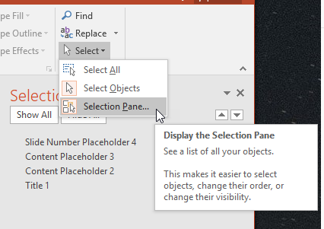
Slide Reading Order
Screen readers will read objects in the order listed in the Selection Pane.
Check the reading order by selecting Home > Select > Selection Pane.

Slide 11
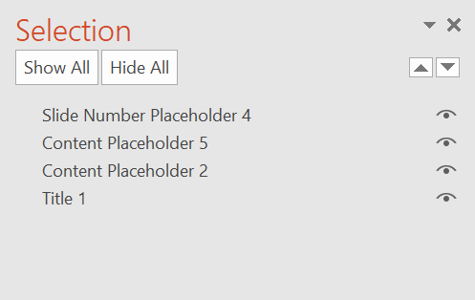
Selection Pane Example
The reading order for the elements on the slide are bottom to top.
For example, the first item a screen reader would announce on this slide would be the text in Title 1, “Selection Pane Example.”
You can adjust the order by selecting object, then the arrow icons.

Slide 12
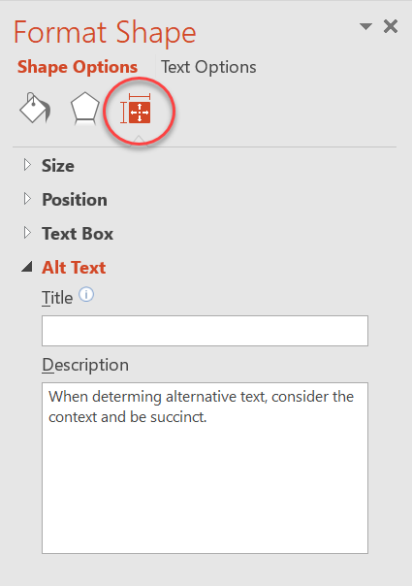
Adding Alternative Text
All non-decorative images should have alternative text or Alt text. Alt text is read by screen readers. This text will also be preserved when exporting to PDF or HTML (making those documents also more accessible)
To add alt text to a non-decorative image:
Right-click the image
Choose Format Picture
Select Size & Properties icon
Choose Alt Text
In the Description field enter proper alt text

Slide 13
Alt Text Best Practices
Review the steps on how to add alt text for your particular version of PowerPoint
Tips for providing helpful alt text
Do not include phrases, “image of,” or “photo of.”

Slide 14
Tables
Only use tables when you have actual table data (headers which correspond to the content in the rows below, etc.)
Most screen readers won’t identify table headers in PPT. However, it’s still recommended.
Select the table.
The Table Tools option becomes visible. Select the Design tab and verify the Header Row is selected.

Slide 15
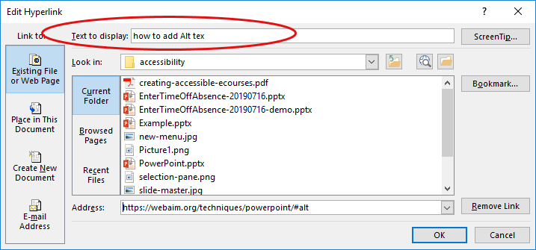
Descriptive Links
Instead of a full URL, or links labeled as, “click here,” provide descriptive text that would let a user know what type of information to expect.
Right-click the link.
Select Edit Hyperlink.
The Edit Hyperlink dialog box will appear. Enter appropriate text in the Text to Display field.
Select OK.
For example, instead of https://webaim.org/techniques/hypertext/link_text, use, Links and Hypertext

Slide 16
Formatting Links
To reduce frustration, keep the appearance of links similar to what users are accustomed to:
Proper contrast from surrounding text
Underlined
For example, Link Appearance

Slide 17
General Considerations
Font Size: Check your font size (especially if it will be viewed on a projector)
Contrast: Ensure there is enough contrast (especially if it will be viewed on a projector)
Color: Do not use color alone to convey meaning
Transitions: Do not use auto transitions for slides
Animations: make sure animations are simple and do not distract from the meaning and content of the slide
Notes pane: Do not put accessibility information into the Notes pane such as alt text for images.
Captions: Ensure videos are captioned
Transcript: Include transcripts for embedded audio

Slide 18
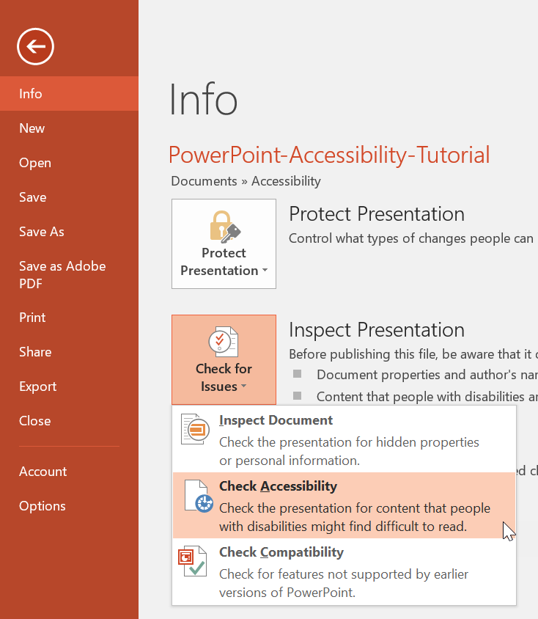
Accessibility Checker
When you’ve completed editing your PowerPoint, run an accessibility test to see if there is anything that needs updates:
Select File > Info.
Select Check for Issues and choose Check Accessibility.
Update PowerPoint accordingly.
See Accessibility Checker Details.

Slide 19
Resources
PowerPoint Accessibility by WebAIM.org
2113401 : 8 Steps to Quickly Make a PowerPoint Presentation Accessible (TrainTraq)
Free web-based training on PowerPoint Accessibility on Access University from Level Access

